Slide 1
Ceiling Fan Support
2020 NEC Changes

Slide 2
2020 NEC Article 314.27 (C)
…Outlet boxes mounted in the ceilings of habitable rooms of dwelling occupancies in a location acceptable for the installation of a ceiling – suspended (paddle) fan shall comply with one of the following:
  Listed for the sole support of ceiling – suspended (paddle) fans.
  An outlet box complying with the applicable requirements of 314.27 and providing access to structural framing capable of supporting of a ceiling – suspended (paddle) fan bracket or equivalent.

Slide 3
Definitions / Scope
Dwelling Units
  Residential – Single & Multiple Dwellings
Habitable areas
  Bed Rooms
  Family Rooms
  Dining Rooms
  Entryways
Where a fan can be installed
  Areas physically large enough
  Excludes outlets in closets or hallways

Slide 4
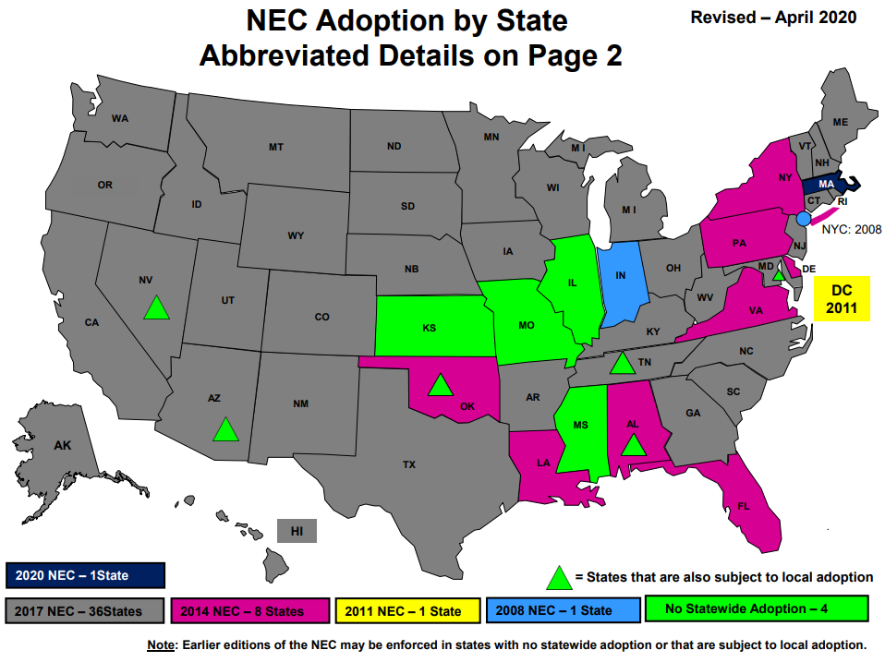
NEC Adoption By State

Slide 5
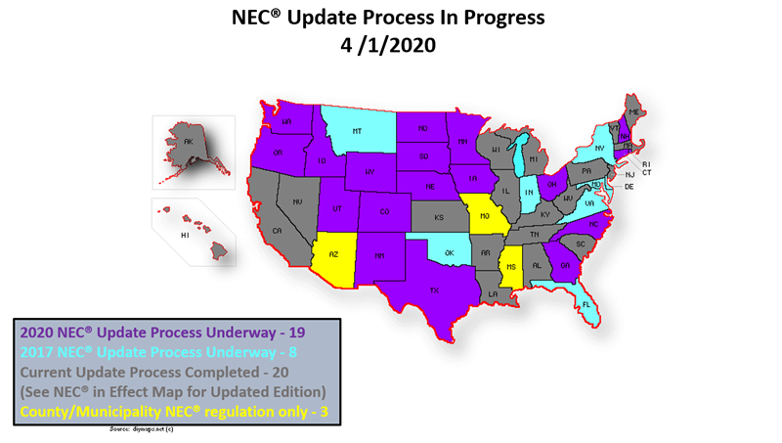
NEC Adoption By State – In Process

Slide 6
Risks to Mitigate
  Demand will gradually change
    Codes take years to change
    Inspectors drive enforcement
  Demand Outstrips Capacity
    Need to forecast accordingly
      RACO’s Ceiling Fan products have longer lead times
  Competition
    Price pressure

Slide 7
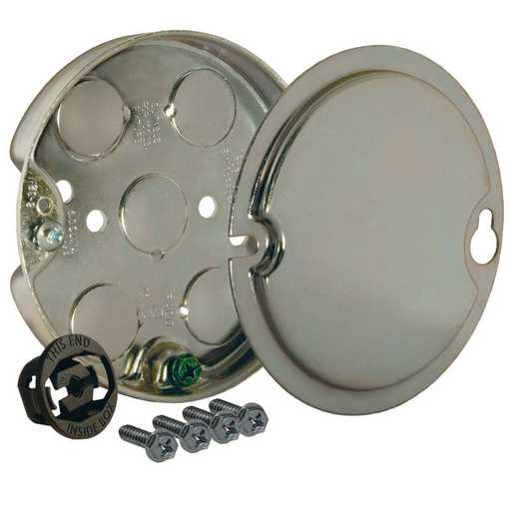
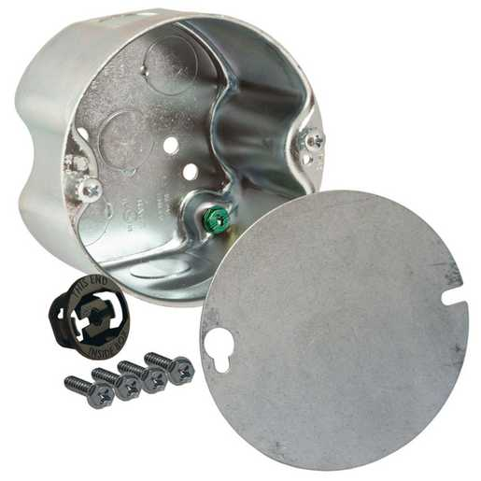
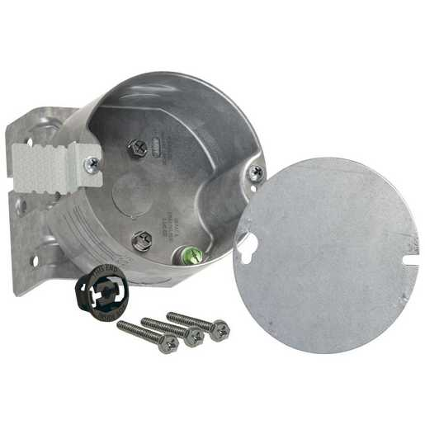
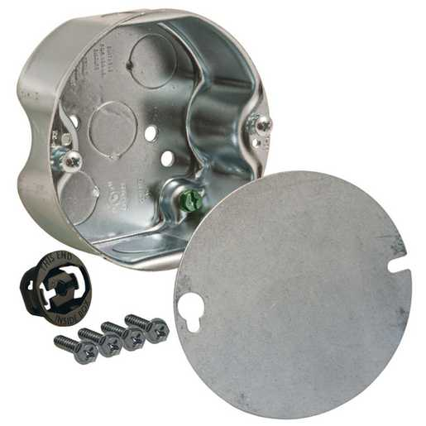
RACO’s Ceiling Fan Box Lineup
295 / 295-1
4” Round
½” Deep
6 Cu. In. Cap.
299
4” Round
2-1/8” Deep
22.4 Cu. In. Cap.
296 / 296-1
4” Round
1-1/2” Deep
15.8 Cu. In. Cap.
294 / 294-1
4” Round
2-1/8” Deep
22.3 Cu. In. Cap.
New work /Old Work

Slide 8
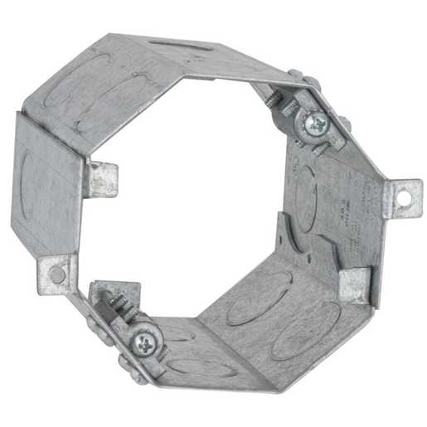
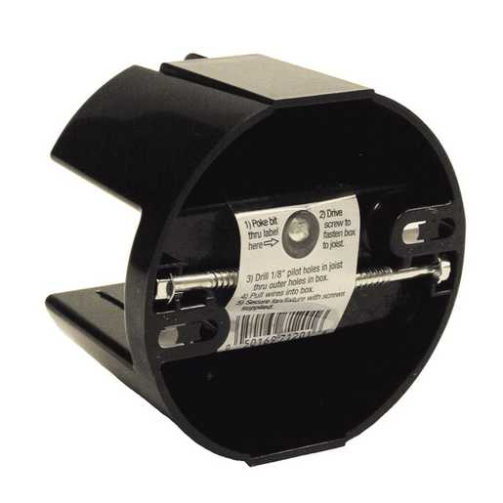
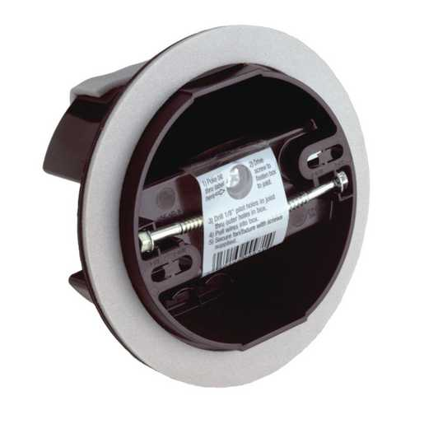
RACO’s Ceiling Fan Box Lineup (cont)
284 Gorilla Ring®
4” Deep
35 lb dynamic rated
49.3 Cu. In. Cap.
7120VB (Vapor Barrier)
4” Round
Non-Metallic
12.5 Cu. In. Cap.
7120 / 7120-1
4” Round
Non-Metallic
12.5 Cu. In. Cap.

Slide 9
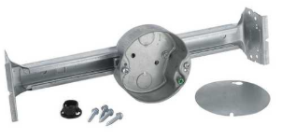
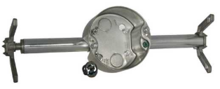
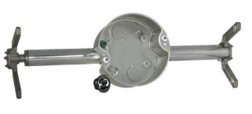
RACO’s Ceiling Fan Box Lineup (cont)
Adjustable between 16” and 24” Studs
926 / 926-1 Kwik-Brace®
4” Round
1-½” Deep
15.8 Cu. In. Cap.
937 Retro-Brace®
4” Round
2-1/8” Deep
22.4 Cu. In. Cap
936 Retro-Brace®
4” Round
1-½” Deep
15.8 Cu. In. Cap.

Slide 10
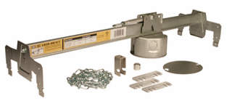
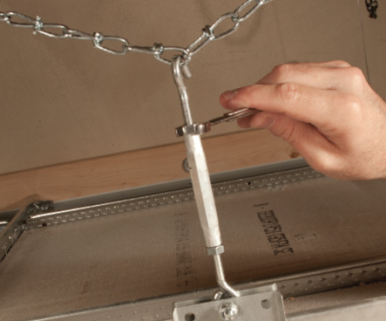
RACO’s Ceiling Fan Box Lineup (cont)
24” Grid Span
931 GRID-BRACE®
4” Round
2-1/8” Deep
22.3 Cu. In. Cap.

Slide 11
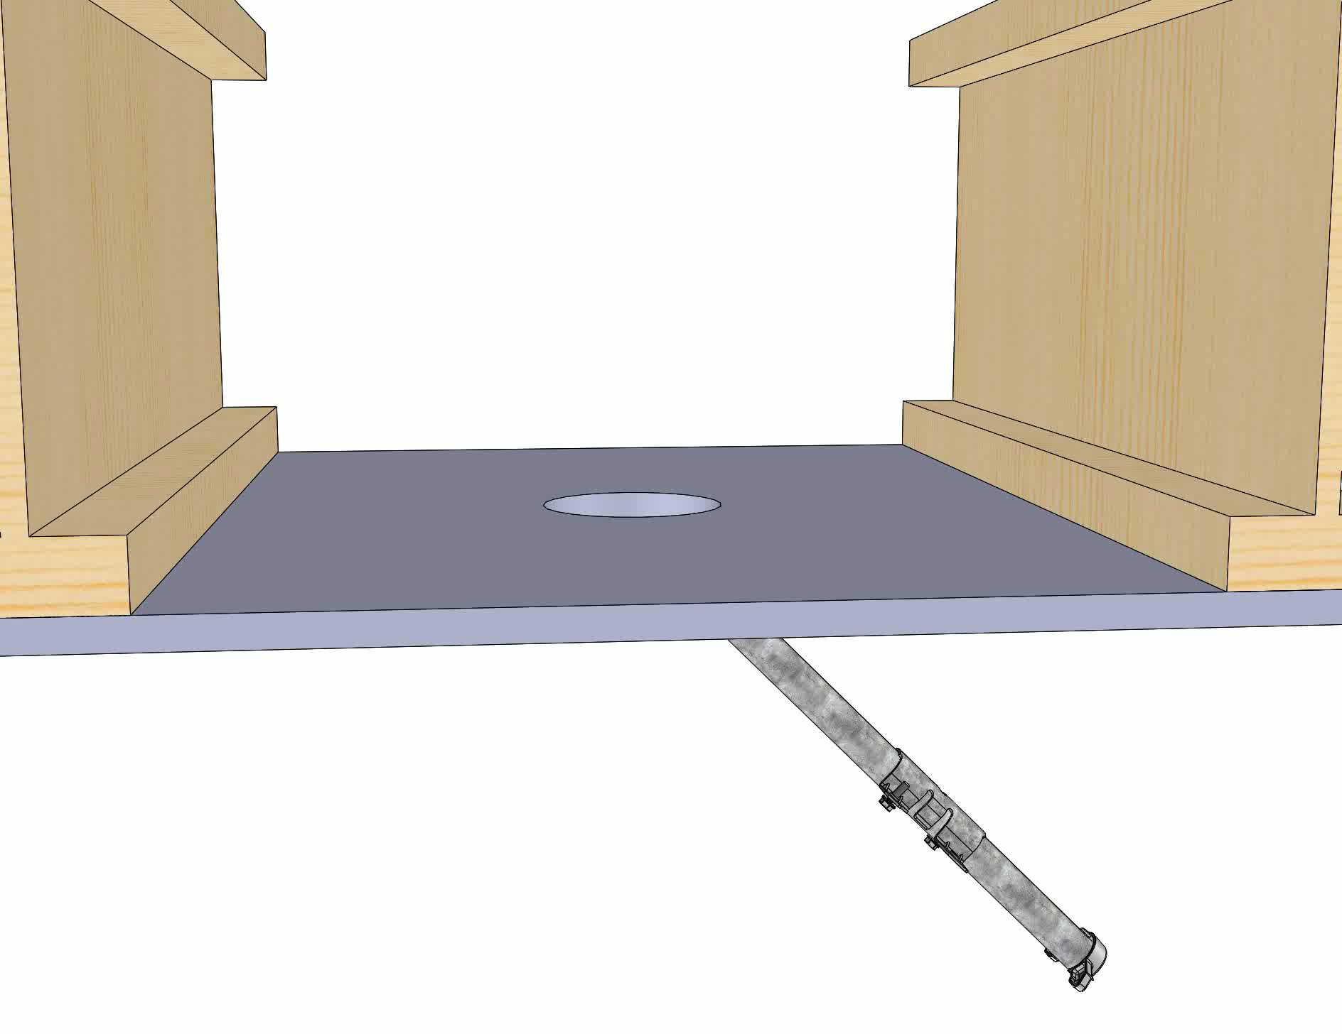
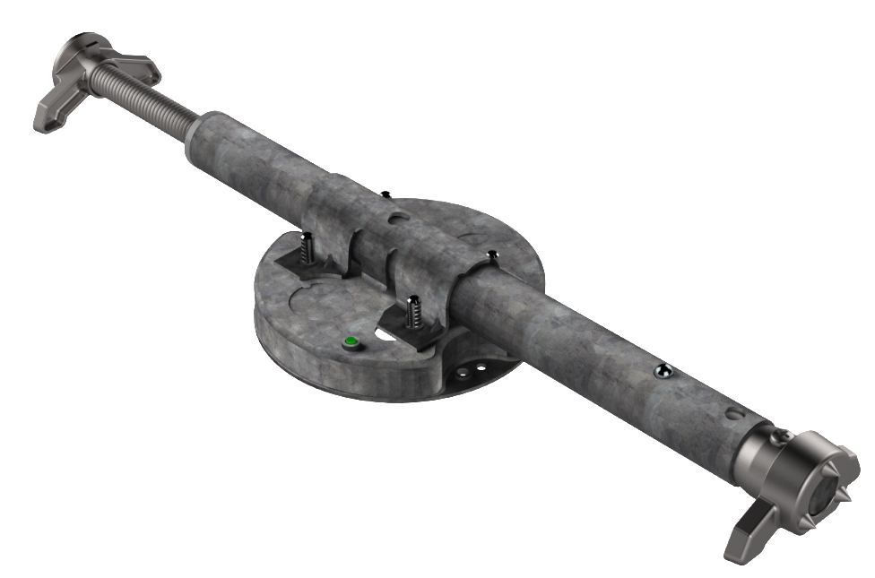
New 939 for Engineered Joists
Available Q3 2020

Slide 12
QUESTIONS?

